Slide 1

FY24 Budget Approval Meeting

Slide 2
Norms
This is a meeting of the GO Team. Only members of the team may participate in the discussion. Any members of the public present are here to quietly observe.
We will follow the agenda as noticed to the public and stay on task.
We invite and welcome contributions of every member and listen to each other.
We will respect all ideas and assume good intentions.

Slide 3
Agenda
Action Items (add items as needed)
  Approval of Agenda
  Approval of Previous Minutes
  Budget Approval (after final presentation/review and discussion)
Discussion Items (add items as needed)
  Presentation of the final budget
Information Items (add items as needed)
  Principal’s Report
    BASC-3 Results (if available)
    Spring ACES Presentation
Announcements

Slide 4

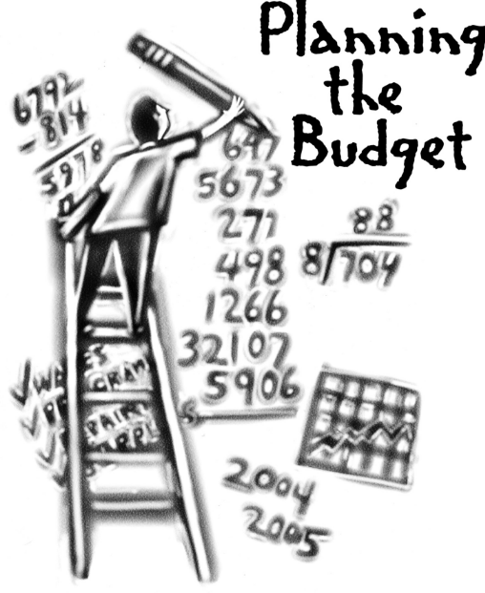
Overview of FY ‘24 GO Team Budget Process
Step 1 Review and Update Strategic Plan and Rank Strategic Priorities
By end of Fall Semester
Step 6 Principals: HR Staffing Conferences Begin
Late February – Early March
Step 3 GO Team Initial Budget Session: Allocation
January 24 – early February
Step 7 GO Team Final Budget Approval Meeting
Budgets Approved by March 17
Step 5
GO Team Feedback Session: Draft Budget Presented & Discussed
February – multiple meetings, if necessary
Step 4 Principals: Associate Supt. Discussions and Review
February (supports needed, specific challenges, coaching)
Step 2 Principals: Workshop FY 24 Budget
January 24, 2023
GO Teams are encouraged to have ongoing conversations about the school’s budget.

Slide 5
Budget Approval Meeting
What
During this meeting GO Teams will review the budget, which should be updated based on feedback from the staffing conference, Associate Superintendents, and key leaders. After review, GO Teams will need to take action (i.e., vote) on the FY24 Budget.
Why
Principals will present the final budget recommendations for GO Team approval.
When
All approval meetings must be held after staffing conferences. Budgets must be approved by March 17th.

Slide 6
Budget Review

Slide 7

FY24 Budget Parameters
FY24 School Priorities | Rationale
Increase Literacy Rate | American Literature EOC scores and the need to hire of a Reading Specialist
Maximize wrap around services ie: Nurse, SSW, Counseling | This continues to be a need for our students; therefore we will add a 4th counselor and a restorative practices coach.
Increase exposure to technology as it relates to signature programming | Student exposure and professional development to everchanging technology as well as preparation for state STEAM certification. We are hiring a local instructional technology specialist.
Notes:
Review the priorities that the GO Team has developed and the rationale for these priorities. Feel free to copy this slide if you have more than 3 priorities to account for.

Slide 8
Descriptions of Strategic Plan
Breakout Categories
Priorities: FY24 funding priorities from the school’s strategic plan, ranked by the order of importance.
APS Five Focus Area: What part of the APS Five is the priority aligned to?
Strategies: Lays out specific objectives for school’s improvement.
Request: “The Ask” What needs to be funded in order to support the strategy?
Amount: What is the cost associated with the Request?

Slide 9
Plan for FY24 CARES Allocation $370,000
Priorities | APS FIVE Focus Area | Strategies | Requests | Amount
CIS & Mental Wellness | Whole Child | Contracted Services for Professional Development | Communities in Schools Program Yoga for Students and Faculty Effect Fitness for Faculty | $100,000
Student Incentives | Whole Child | Teaching/Other Supplies | TBD | $39,886
Teaching/Learning | Data & Instruction Personalized Learning | Assisting with personalized learning and learning loss | Paraprofessional | $80,000
Teaching/Learning | Data & Instruction | Tier 2 & 3 Interventions | SST Intervention Specialist | $130,000
Notes:
For the next few slides, I will show you how I have allocated the budget to support our strategic priorities.
Based on our strategic priorities and funds we received, here is a break-out of the priorities, which focus area it addresses, the strategies that will be implemented, the purchase request, which funding source was used and the amount.

Slide 10
Plan for FY24 Title I Family Engagement Funds
$15,000
Priorities | APS FIVE Focus Area | Strategies | Requests | Amount
Transportation for Parents | Whole Child | Provide transportation for parents to events | Uber or Lyft Cards | $10,000
Professional Development Workshops | Whole Child | Curriculum Nights, Principal’s Chat | Supplies, Marketing material, manipulatives | $5,000
Notes:
For the next few slides, I will show you how I have allocated the budget to support our strategic priorities.
Based on our strategic priorities and funds we received, here is a break-out of the priorities, which focus area it addresses, the strategies that will be implemented, the purchase request, which funding source was used and the amount.

Slide 11

Staffing Conference Changes
There were not any changes made to the draft budget we discussed at our last meeting.

Slide 12
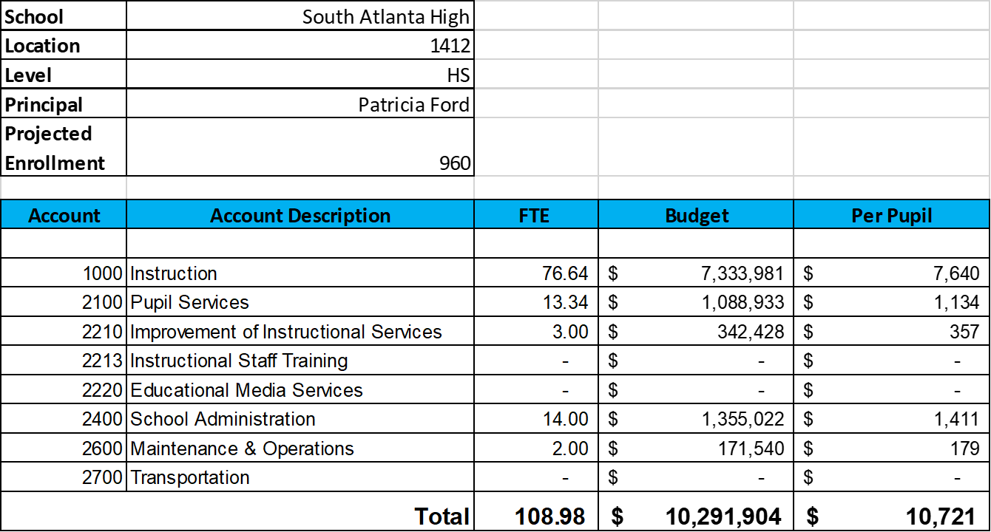
Budget by Function (Required)
*Based on Current Allocation of School Budget

Slide 13
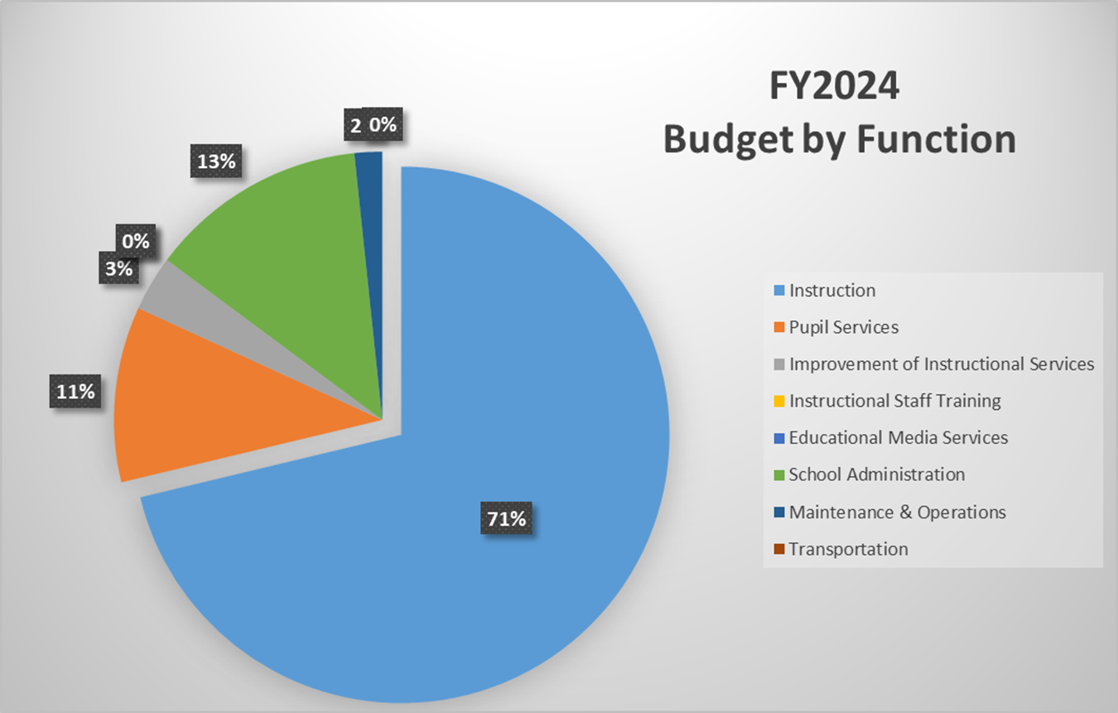
Budget by Function (Required)
*Based on Current Allocation of School Budget

Slide 14
Discussion of reserve and Holdback funds

Slide 15
Plan for FY24 Title I Holdback $60,096
Priorities | APS FIVE Focus Area | Strategies | Requests | Amount
Teaching/Learning | Curriculum & Instruction | Implement a Reading Specialist for struggling readers/writers | Hire a Reading Specialist | $60, 696
Notes:
For the next few slides, I will show you how I have allocated the budget to support our strategic priorities.
Based on our strategic priorities and funds we received, here is a break-out of the priorities, which focus area it addresses, the strategies that will be implemented, the purchase request, which funding source was used and the amount.

Slide 16
Questions for the GO Team to Consider and Discuss
Are our school’s priorities (from your strategic plan) reflected in this budget?
Are new positions and/or resources included in the budget to address our major priorities?
Do we know (as a team) the plan to support implementation of these priorities beyond the budget (ex. What strategies will be implemented)?
What tradeoffs are being made in order to support these priorities?
How are district and cluster priorities reflected in our budget?
Cluster priorities- what staff, materials, etc. are dedicated to supporting our cluster’s priorities?
Signature programs- what staff, materials, etc. are dedicated to supporting our signature program?
Are there positions our school will share with another school, e.g. nurse, counselor?
Notes:
CHAIR - Our final task for today! Here are questions that we need to consider to ensure we have a good working draft budget. Let’s walk through them together.

Slide 17

Questions?

Slide 18
The GO Team needs to TAKE ACTION (vote) on the presented budget. After the motion and a second, the GO Team may have additional discussion. Once discussion is concluded, the GO Team will vote.
Action on the Budget

Slide 19

2023 Spring ACES
Accountability
Collaboration
Equity
Support

Slide 20
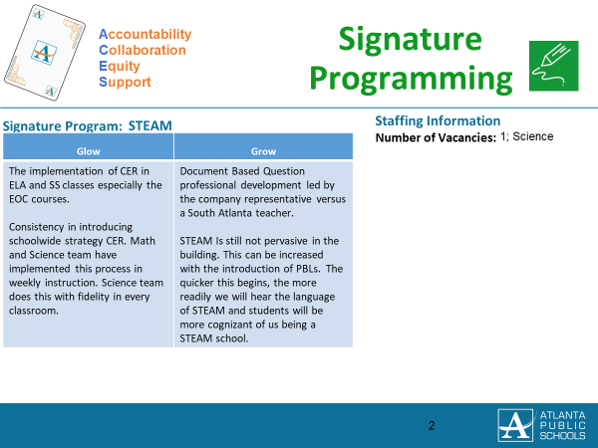

Slide 21
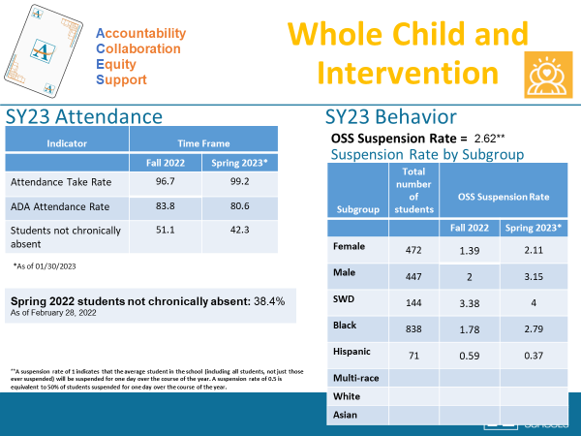

Slide 22
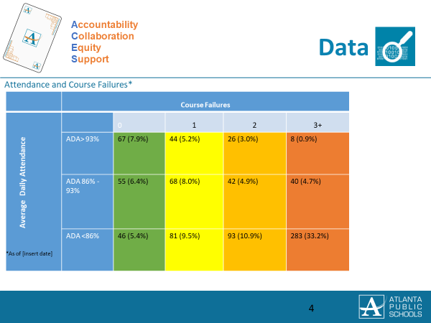

Slide 23
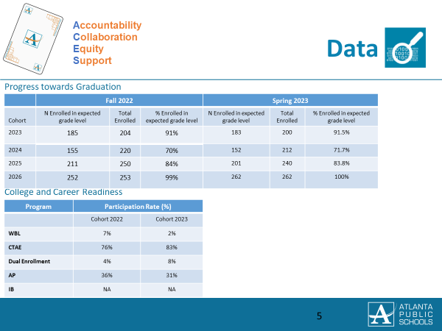

Slide 24
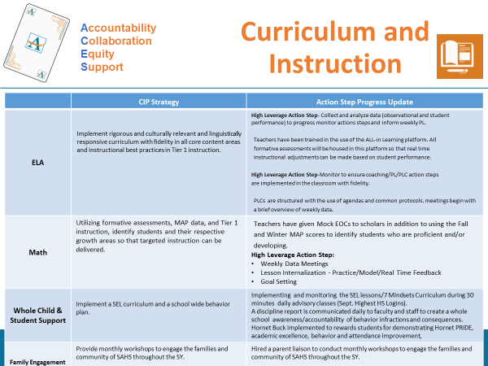

Slide 25
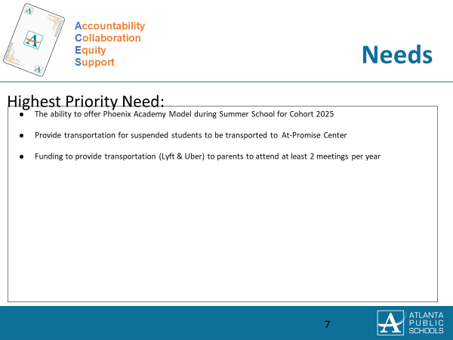

Slide 26
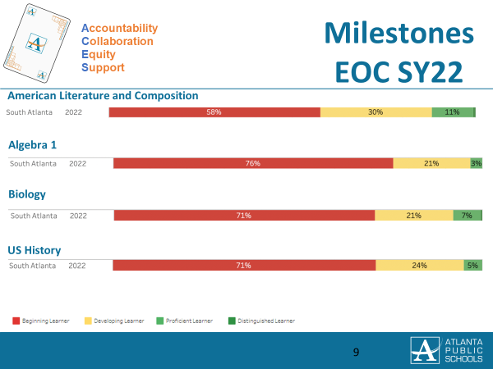

Slide 27
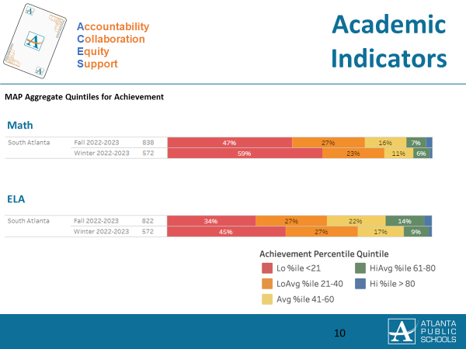

Slide 28
Questions?

Slide 29

Thank you

